Slide 1
Programming for games
L10 – Texture blending

Slide 2
Brief
We’ve covered texturing
UV coordinates, texture resource views, mipmaps
Aims
Multi-texturing
Texture blending
Alpha transparency
Outcomes
Describe how textures can be blended to achieve a range of effects
Use texture blending in simple applications

Slide 3
Simple texturing - reminder
Vertex shader outputs a UV coordinate in each vertex of each primitive
These values are interpolated and feed into the pixel shader, one pixel at a time to fill it in
Use a texture resource view, a sampler and a UV coordinate to look up a colour RGB and possibly an alpha value RGBA
The pixel shader can modify the colour
Output the colour

Slide 4
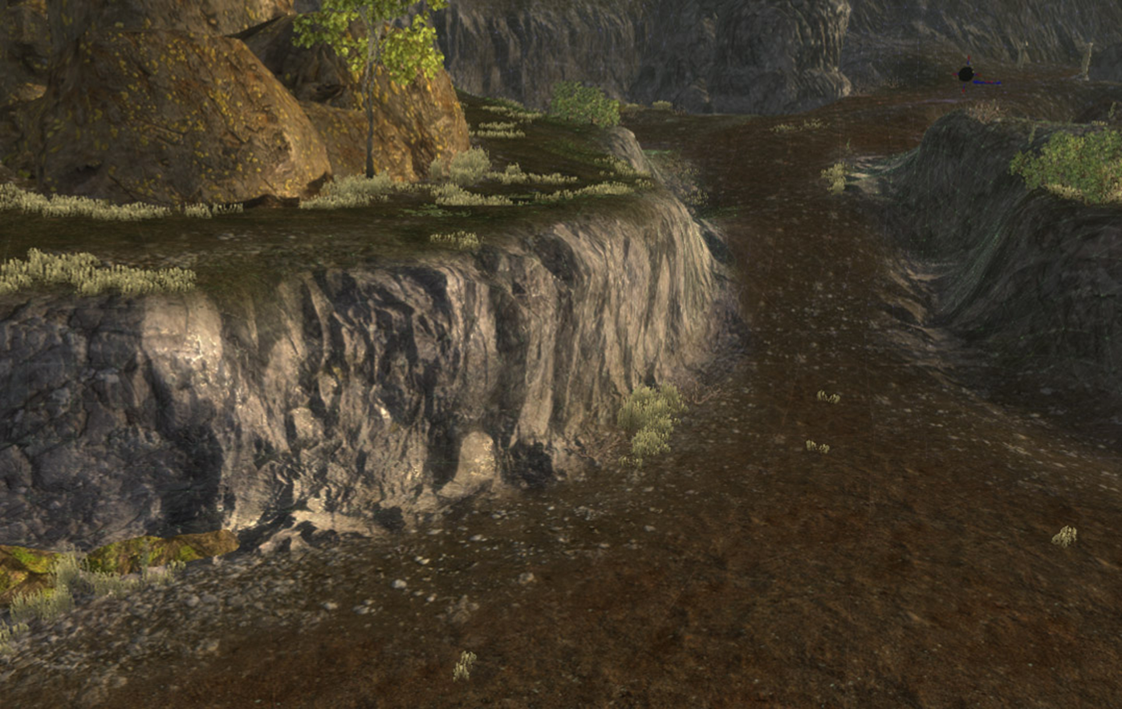
The blended result

Slide 5
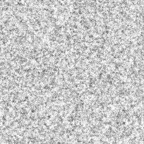
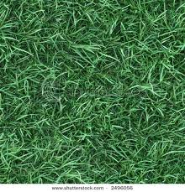
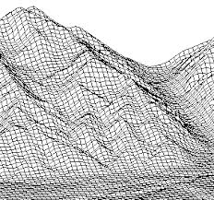
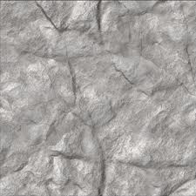
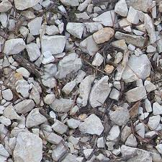

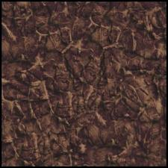
Why blend textures?
Noisy detail
Grass
Use textures that tile
Use alpha or the colour or another texture to control how and where they blend together.
Perhaps store height in a texture and switch based on that.
Render miles of terrain in one pass (or a small number)
Vertex data
Rock
Gravel
Mud

Slide 6
Multi-texture or Multi-pass?
Pixel shader outputs RGBA colour value for each pixel
Multi-pass:
Use output merger stage to blend in the colour over many renders
New colours can be added, subtracted or multiplied into the buffer
Multi-texture (faster):
All textures are present when the pixel shader runs
Pixel shader blends them together (add / mul / sub / other)
Output merger stage replaces screen buffer colour – normal

Slide 7
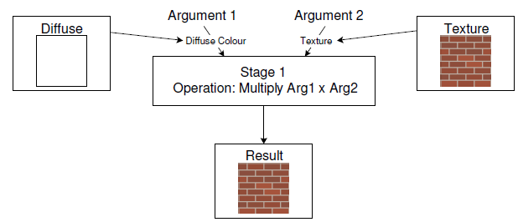
Blending textures and lights
Vertex shader produces normals which are then interpolated and fed into pixel shader
The previous texture calculations are performed, but now we have a light colour too
This can be multiplied onto our texture colour – darkens, lightens or tints the colour

Slide 8
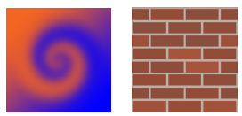
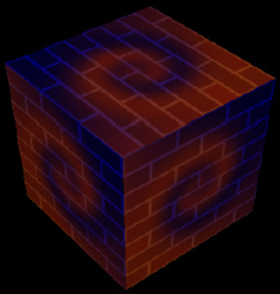
Texture to texture blending
We can add more UV coordinates to our vertex buffer, blending different texture areas
Or we can use the same UVs, blending the same area of different textures
This is the technique that allows huge unique landscapes with only a few textures

Slide 9
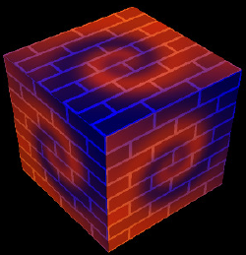
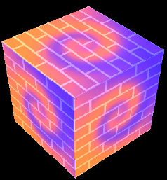
Multi texture blending
The pixel shader can combine textures in many different ways
Here the textures are being combined with multiple multiplications
End result gets brighter
A nice cheap glow type effect, it's your pixel shader so anything is possible

Slide 10

Texture matrix
UV coordinates are just 2D coordinates like any other coordinate system
We can use standard matrix transforms
Scale the texture up – magnify
Scale it down – minify
Translate – make the texture appear to move or scroll
Rotate – clockwise or anticlockwise, not too common
The matrix relies on the sampler to be setup appropriately
If it’s set to wrap we’ll see repetitions

Slide 11
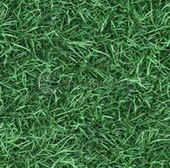
Scrolling
Create X variable, add a little each update
Use it as a translation to build and update the texture matrix
Grass appears to scroll left
What happens when X > 1 ?
If sampler is set to wrap, you get smooth infinite scrolling

Slide 12
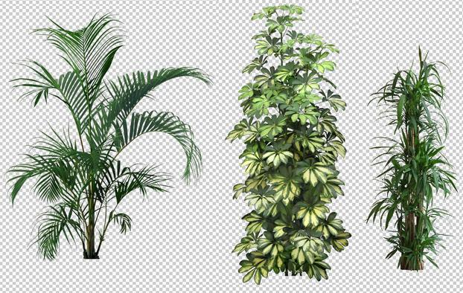
Transparency - alpha test (punch through)
Alpha test the pixel in the pixel shader
If alpha is zero (or less than 0.5 to take account of sampling) discard or clip away the pixel
No need to sort
float4 color = gTexture.Sample( gSampler, input.tex ) * input.lightColour; if( color.a < 0.5 ) discard; return color;

Slide 13
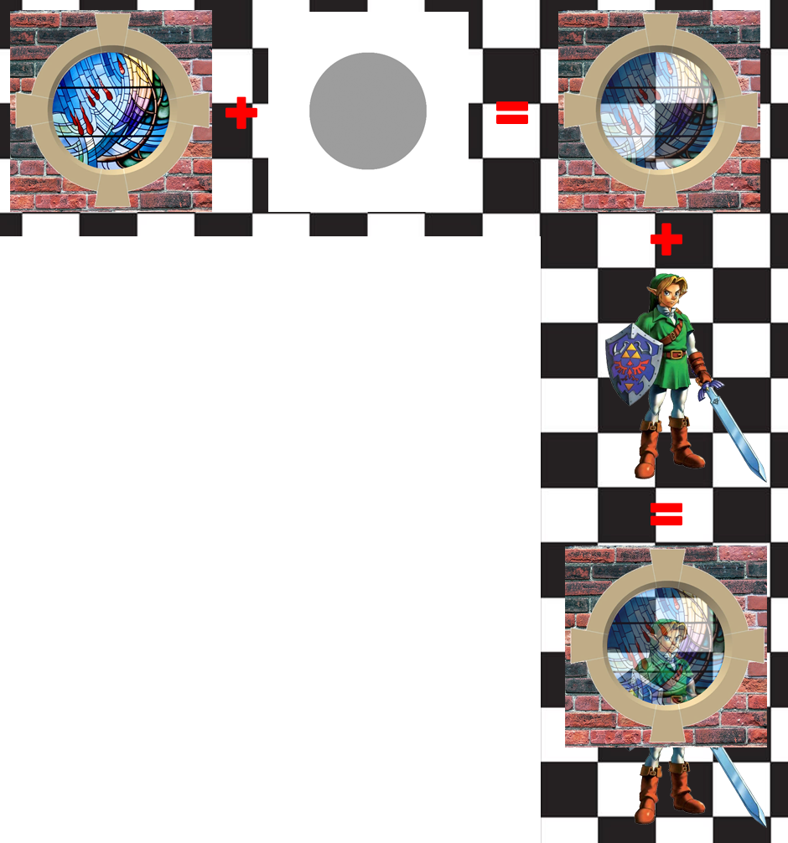
Transparency - texture alpha blend states
Just as colour can consist of ARGB – A=alpha transparency
An image can carry an alpha channel too
This grey looking image controls the transparency of each texel.
However - order is important! What happens if Link is rendered after the window?
Render all opaque models first.
Sort all transparent models, render back to front.

Slide 14
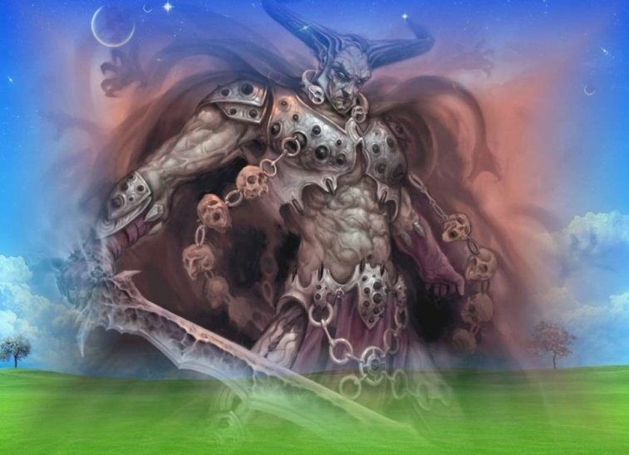
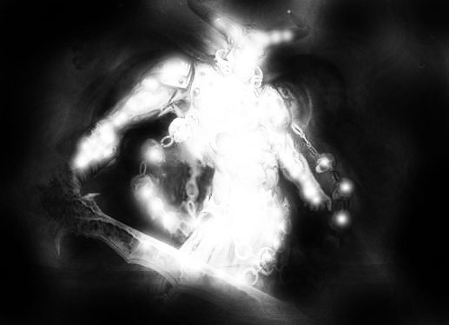
Transparency - texture alpha blending
Final Pixel Colour =
(Source Pixel Colour x Source Alpha)
+
(Destination Pixel Colour x 1/Source Alpha)
Source pixel – the colour after textures are applied.
Destination pixel – the colour in the background at the position about to be rendered.
All configured through a blend state, puts the texture alpha in control. It configures the final stage of the pipeline.

Slide 15
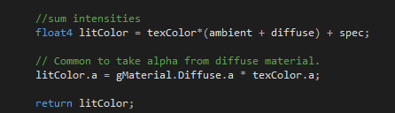
Transparency - texture alpha blending
Material setting still play a part though - look at the pixel shader
From PSCore.hlsl
They way we've written this, the material diffuse alpha can modulate what the texture alpha is trying to do - be careful not to set it to zero!

Slide 16


Transparency - blend factor alpha blending
Final Pixel Colour =
(Source Pixel Colour x Blend Factor)
+
(Destination Pixel Colour x 1/Blend Factor)
Similar to previous blend state, but the blend factors control how much of each colour makes it to the final pixel.
There are many other possible combinations for other kinds of effects.

Slide 17
Transparency - summary
Input assembler
Memory Resources
Vertex shader
Alpha test
pixel shader discards any pixels alpha<0.5
Texture alpha
Output merger stage looks at the alpha in the colour pixel coming out of the pixel shader stage
A modulation of material.diffuse.a X texture.a
Blend factor alpha
Output merger stage is given blend factors directly
Set by the game code directly
Rasterizer
Pixel shader
Output merger

Slide 18

Control
Create more than one rasterizer state, select at run time
Filled, wireframe, cull, no culling, clockwise, anti-clockwise
Create alpha transparency blend state, transparent blend state (blend factors), default blend state select at run time
Extend the MaterialExt structure
More flags
Blend factors
Texture transform matrix: scale, translate, rotate

Slide 19
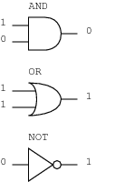
Bit flags
There are lots of on/off settings going into the material
unsigned int flags = 0 //32 bits
enum { APPEND = 1, TRANSPARENCY = 2, LIT = 4, etc }
flags = APPEND | LIT; //set some initial flags
flags |= TRANSPARENCY; //add a new flag
flags &= ~TRANSPARENCY; //turn a flag off
if( (flags&TRANSPARENCY) != 0 ) //test if a flag is set
//setup transparency

Slide 20
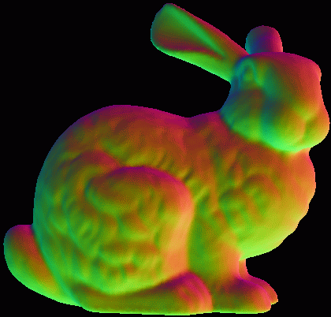
Material reminder
Material defines surface properties
diffuse (+alpha), ambient (+alpha), specular(+power)
texture, lit, cull, wireframe, CCW
1. The mesh has an embedded default material
2. Multiple model instances share the same mesh
model specifies position, rotation, scale
model can specify an override material to use instead of the default
3. FX::Render( model, d3dcontext, &material )
render function can be given a temporary override material

Slide 21
Model reminder
Mesh &mesh = mgr.CreateMesh("quad"); //only ONE mesh!!!
A class scoped model (lives as long as the class)
A local variable model
class Game
{
public:
Model mTree;
void Init(Mesh& mesh) { mTree.Initialise(mesh); }
};
void Game::func() {
Model tree2 = mTree, tree3 = mTree;
tree2.GetPosition() = Vector3(1,0,0);
mFX.Render(tree2, gd3dImmediateContext);
}

Slide 22
Review
Access multiple textures to perform complex blends fast
Or just render multiple times and control the output merger state
Multiply light and texture for tinted, light or dark surfaces
Blend textures to get complex and varied effects (glow, detail)
Use texture matrix to scroll, magnify, minifi, rotate
Use blend factors to enforce transparent blending
Use texture alpha for more subtle alpha transparency control

Slide 23
Tutorial
Go to Black Board
notes, DX example and tutorials
Week 10 texture blending
?

